Slide 1
pTrc Msip34_2177 pCM66T

Slide 2
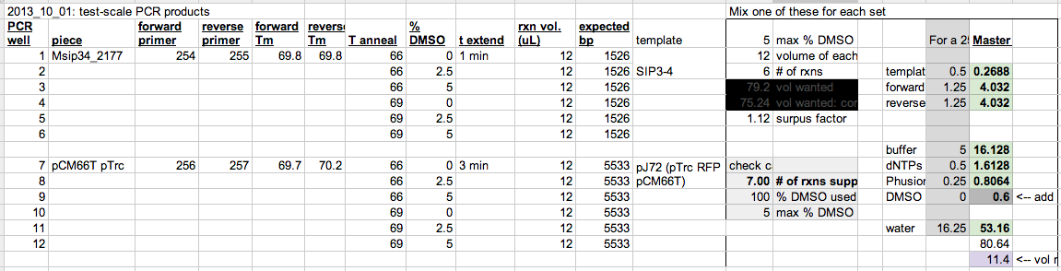
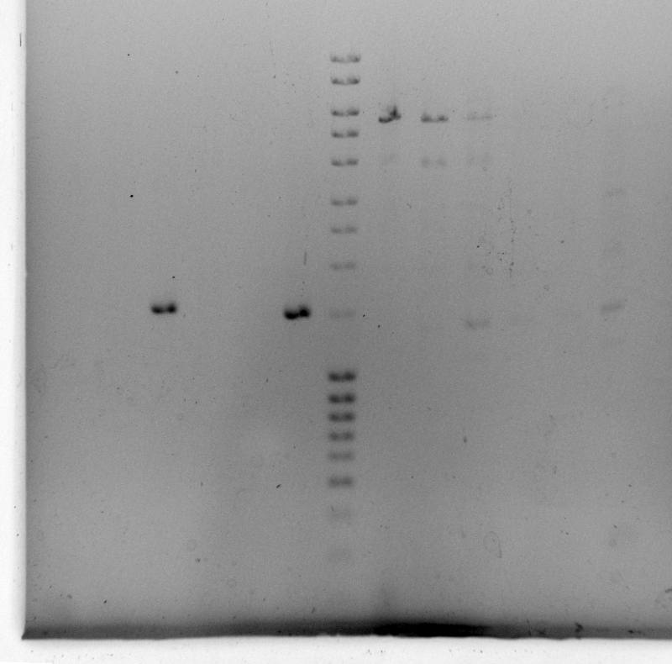
Make 40 uL of well 6
Make 80 uL of well 7. May need to gel purify.

Slide 3

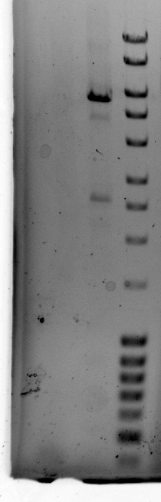
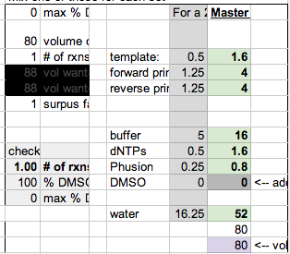
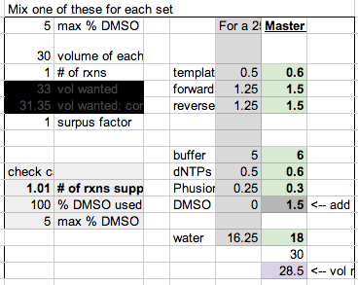
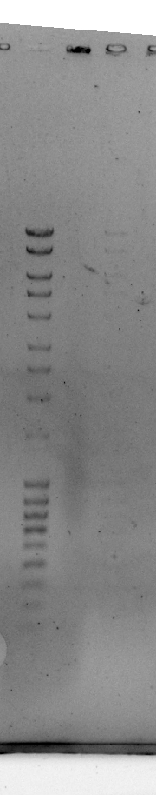
Well 14 worked well enough. Probably won’t gel purify phantom bands. PCR backbone instead.
Do need to re-do well 13. Try exact same thing for now.

Slide 4
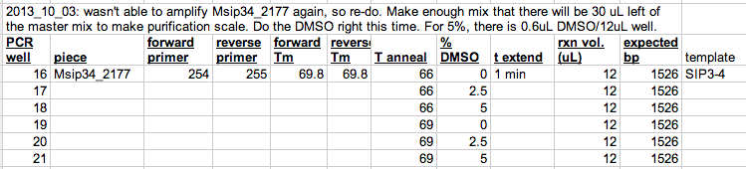
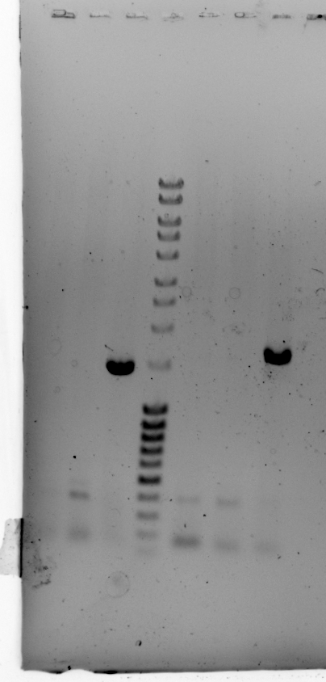
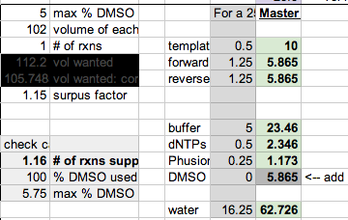
Do more of well 18

Slide 5
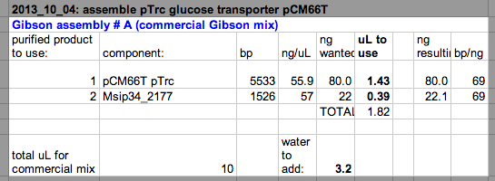
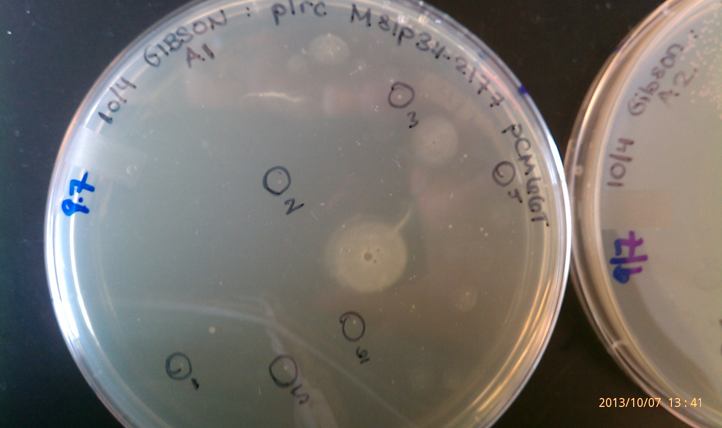

Slide 6
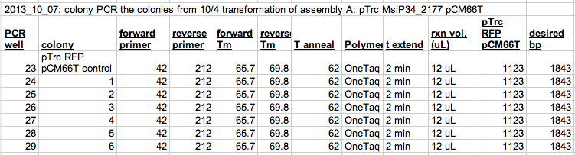
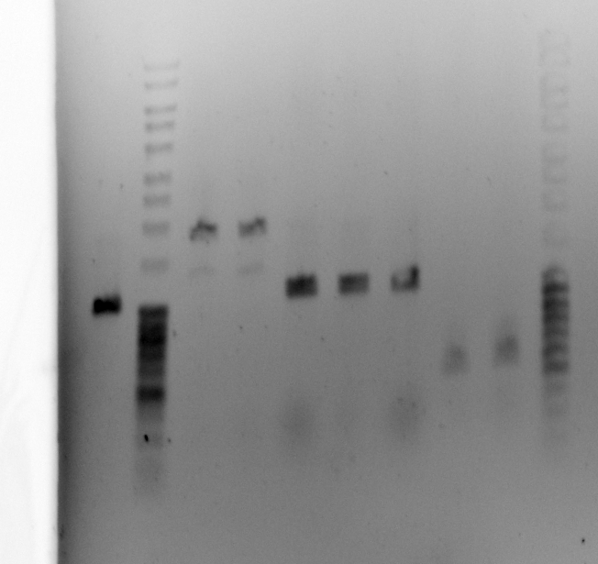
Restreak colonies 1 & 2.
Restreak others that look like they might be worth colony PCR-ing.
Also restreak a handful that I haven’t done colony PCR on yet.

Slide 7
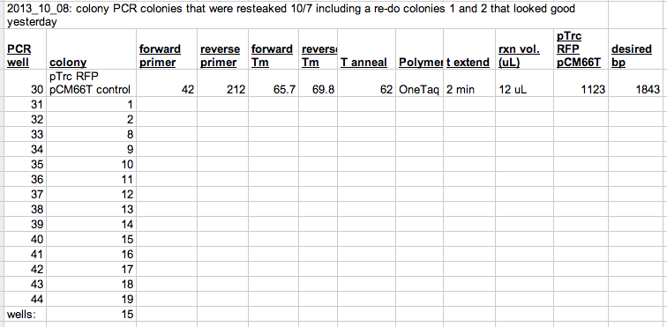
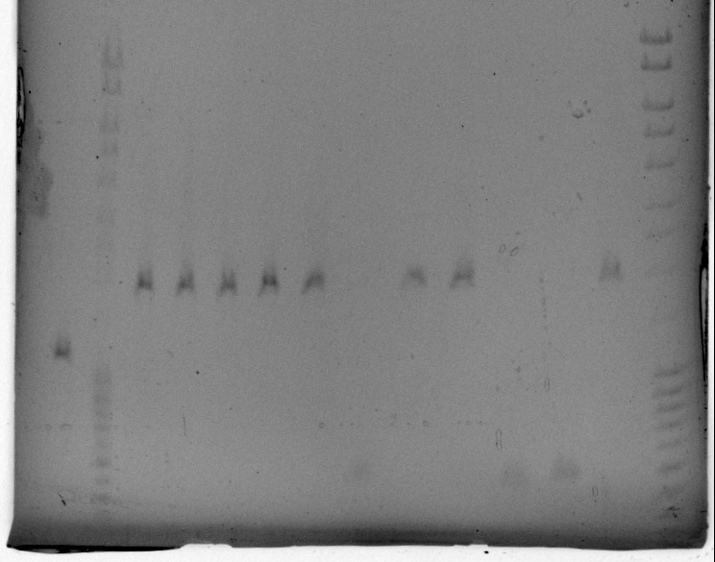
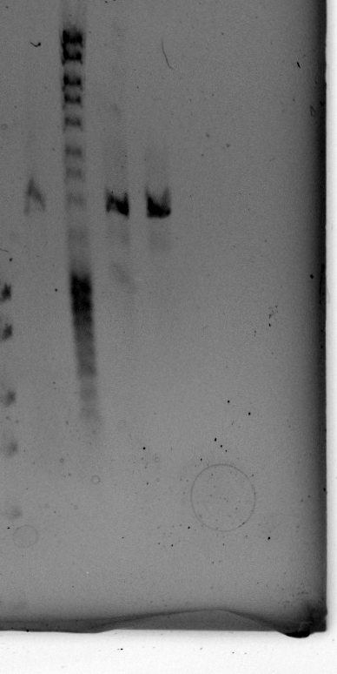
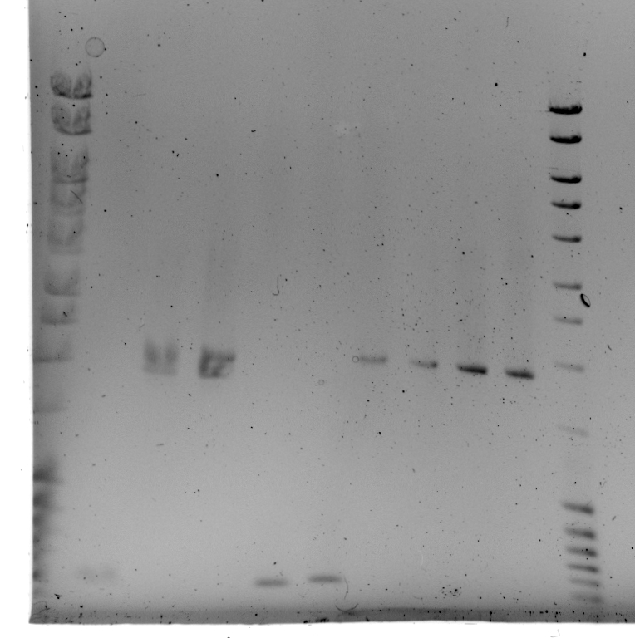
1031
1031
800
800
600
*
600
Re-ran wells 36-44. Restreak 12, 13, 16-19
Hard to say if I re-ran something twice. Re-run #s 11-19 (19 hasn’t been run yet)
Inoculate # 1, 2, 8, 9. Restreak # 10,
pTrc RFP control
16
17
18
1
2
8
11
12
13
14
15
16
9
10
Forgot to run well 44.
11
12
13
14
15
16
17
18
19

Slide 8
Colonies sequenced worked great. Committed.

